Slide 1
Aerospace Design and Systems Engineering Elements II AE2111-II aircraft part
Aircraft aerodynamic analysis – Estimation of Lift & Drag
Dr. F. Oliviero
Flight Performance & Propulsion Group (FPP)

Slide 2
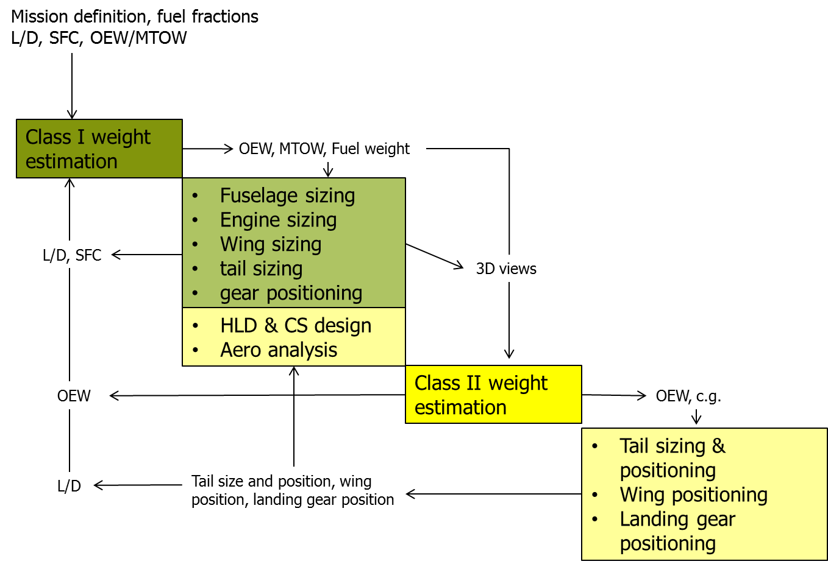
Contents of the lecture
Today we are focusing our attention on the two most important forces acting on the plane during flight:
How to calculate the Lift and the Drag?
Notes:
2

Slide 3
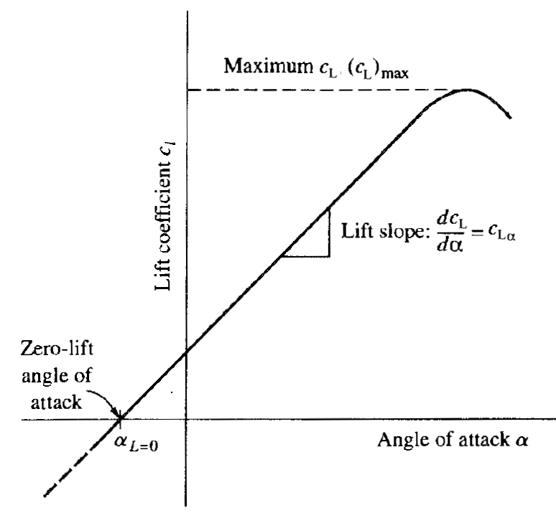
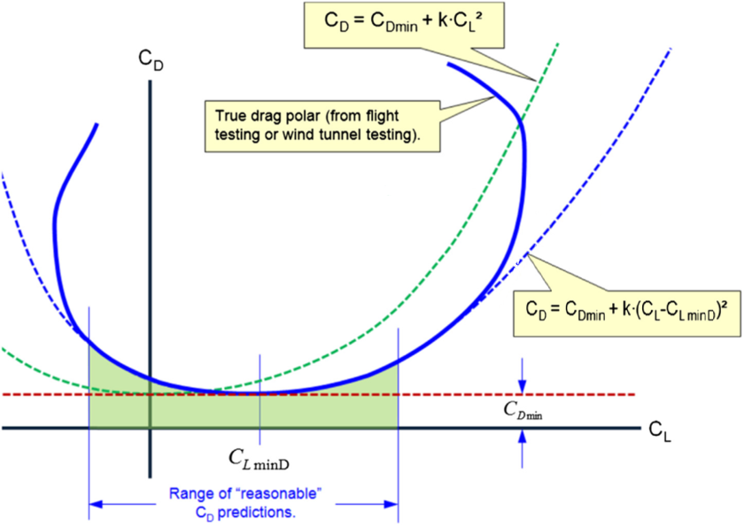
Content of the lecture
Generation of the C_{L}-α curve for the clean wing
Effect of sweep, aspect ratio and compressibility on CLα
DATCOM method for CLα estimation
DATCOM method for CLmax and α_{stall} estimation (for High and LOW aspect ratio wings)
Fig. source: Anderson
Estimation of the polar drag
Classification of the drag components
Estimation of the parasite drag
Estimation of the miscellaneous drag
Estimation of the induced drag
Notes:
3

Slide 4
0: Additional questions
Notes:
4

Slide 5
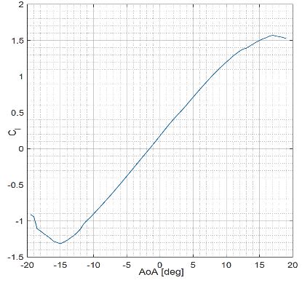
What is the value of the stall AoA for this airfoil?
102/119
Join at: vevox.app
ID: 165-949-420
Question slide
- 15 [deg]
0%
10 [deg]
0%
15 [deg]
0%
20 [deg]
0%
None of the listed value
0%

Slide 6
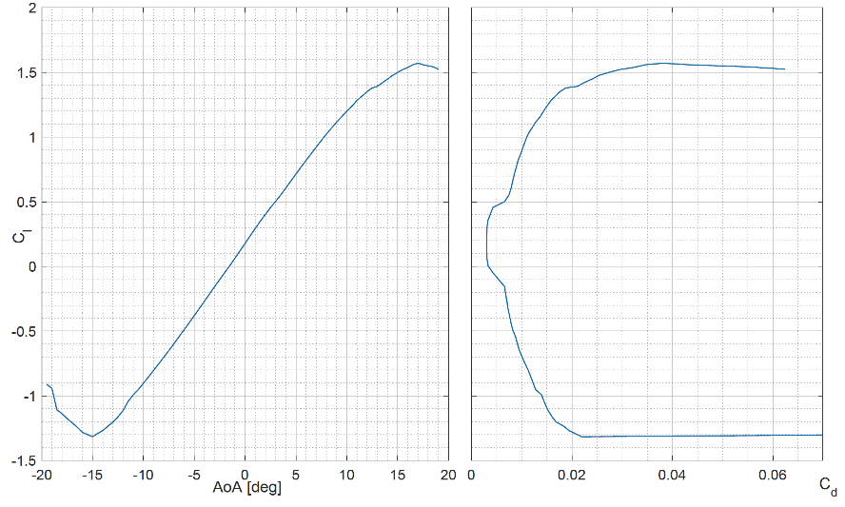
What airfoil can be represented by those graphs?
72/122
Question slide
Join at: vevox.app
ID: 165-949-420
NACA 20012
0%
NACA 64(1)012
0%
NACA 64(3)212
0%
NACA 23212
0%

Slide 7
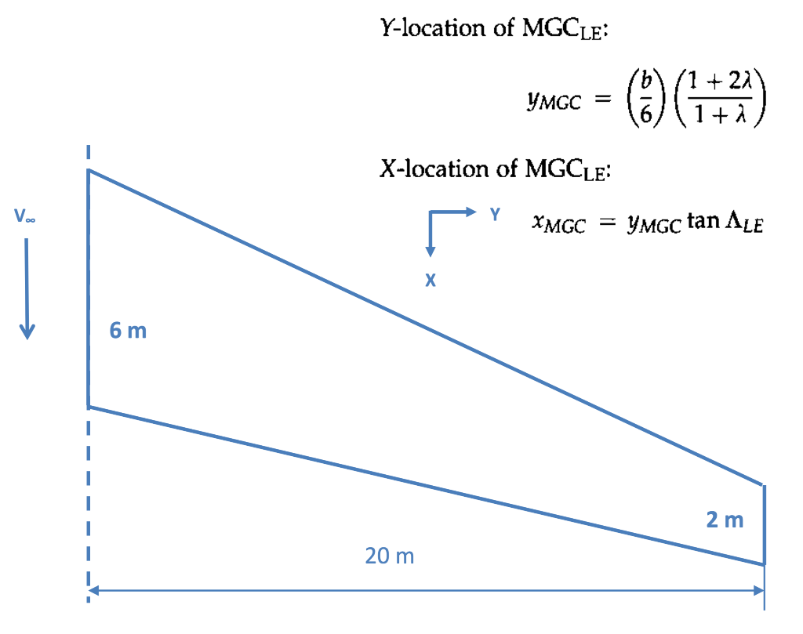
What is the span wise position (in m) of the Mean Aerodynamic Chord of the wing reported in figure?
48/117
Join at: vevox.app
ID: 165-949-420
Question slide
2
4
6
8
10
12
14
16
Mean:

Slide 8
Lift curve of the clean wing
1.1 CLα
α
Notes:
8

Slide 9
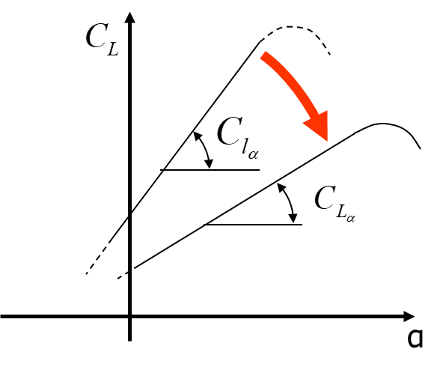
Evaluation of the wing lift curve slope
The effect of a finite wing span on the 2D lift coefficient C_{l} * is to reduce the slope of the lift curve.
The downwash velocity component w_{i} induced by the tip vortices reduces the effective wing angle of attack, hence it reduces the amount of generated lift at a given angle of attack.
→ the lift-curve rotates clockwise.
Question: How much does C_{Lα} differ from C_{lα}?
It depends on 3 main factors:
Aspect ratio (A)
Compressibility effect (M)
Sweep angle (Λ)
Notes:
9
*Tipically 2π for incompressible flow!
Why a rotation around Alpha zero lift? Because when the generated lift is zero, there are not tip vortices, hence now downwash, hence the wing behaves as its own airfoil.
Actually at transonic speed also the airfoil thickness has an influence on CLalpha (see next slide).

Slide 10
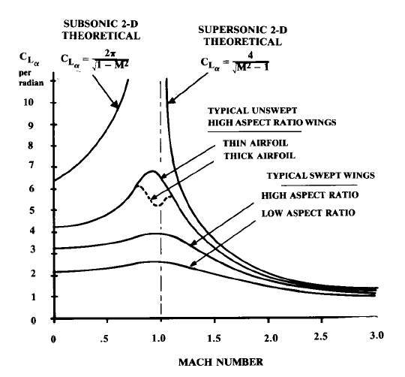
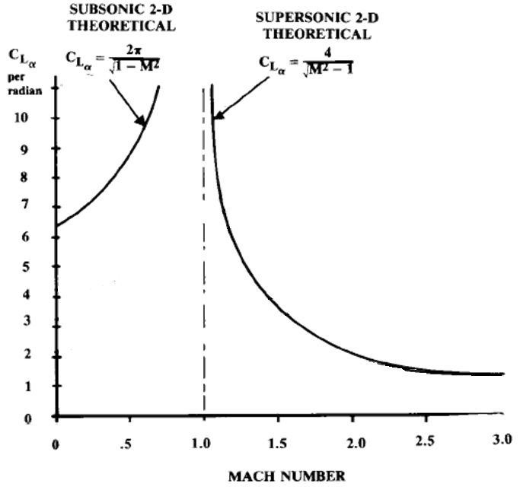
Effects of aspect ratio, compressibility, airfoil thickness and sweep angle on C_{Lα}
t/c ≤5%
A > 4
Sweep
A
Source Raymer
Notes:
10
Generally it is true that C_{Lα} of a wing built with a certain airfoil is lower than C_{lα} of the given airfoil working at the same angle of attack! That is always true for untwisted wings of finite length, when airfoil and wing are considered working at the same Mach number!
Generally C_{Lα} stay also below 2π. However, in the specific case of unswept, high aspect ratio wings built with thin airfoil and operating at Mach number close to 1, it is possible that C_{Lα} > 2π as shown in the plot above!
ATT! The finite length wing curves above are just examples to show general trends. You will have to compute the C_{Lα} for your wing!

Slide 11

Evaluation of the wing lift curve slope
The following SEMI-EMPIRIC equation (based on DATCOM method) accounts for the effect of A, M and Λ
→ Units [1/Rad]
*
: Prandtl-Glauert compressibility correction factor
: Sweep angle measured at half chord length
: Airfoil efficiency factor**
Compressibility contrib.
Sweep angle contrib.
Aspect ratio contrib.
Notes:
11
Obviously, the equation above can be used also in case of uncompressible flow (β = 1). In this case the effect the sweep angle is still accounted by the term tan²Λ_{0.5C.}
In case of A = ∞ and β = 1, all the terms at the denominator become neglectable compared to A, hence the slope of the curve becomes the same as for the 2D case, i.e. 2π.
N.B. In case you are using winglets you can increase A by 20%, which is quite a realistic figure, although the actual increase of the effective aspect ratio really depends on the good design and sizing of the winglet itself.
Note how the slope of the wing lift-curve depends just slightly on the kind of airfoils used, via the term η. In the end, also the lift-curve slope of an airfoil is always very close to 2π, whatever the geometry of the airfoil. However, the type of selected airfoil strongly affects the maximum lift coefficient of the wing, as discussed later in this lecture.
*Remember to indicate the units!!!! Divide the calculated curve slope value in 1/rad by 57.3 in order to have that in 1/deg.
** Unless you know the airfoil lift gradient as function of Mach from experimental data (i.e., NOT from Javafoil, Xfoil, etc..), then use the value 0.95 for a good approximation.

Slide 12
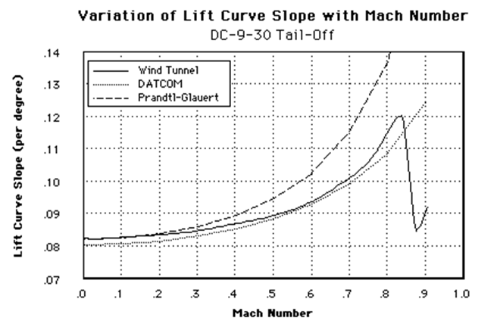
Evaluation of the wing lift curve slope
How accurate is the DATCOM method for CLα estimation?
EXAMPLE
The DATCOM method is very accurate until very high Mach numbers (above divergence). Errors in the order of 2-4% occur for unswept or moderately swept wings (<20 deg).
When using semi-empiric methods, one should always check the validity of the models.
Notes:
12
Note how the simple use of the Prandtl-Glauert compressibility factor to correct the lift-curve slope for the wing would yield a large overestimation, mainly because it does not account for the effect of the wing aspect ratio.

Slide 13
Characterization of the linear part of the C_{L}- α curve
for
This is just a characteristic of the airfoil
Notes:
13
α_{0L} depends on the camber of the airfoil! It does not change when you go to 3D (unless your wing is built up of different airfoils and/or is twisted and/or is mounted on the fuselage at an angle of incidence).
In case of a twisted wing, it is opportune to consider the zero lift angle of attack of the airfoil at the MAC.

Slide 14

Definition and evaluation of the wing trim angle (α_{trim})
*
α_{trim} is the angle of attack at which the wing has to fly in order to deliver the design lift coefficient C_{Ldes}.
Effect of finite aspect ratio
α
The wing, due to its finite length, has to be set at a higher angle of attack than the airfoil. The lower the lift curve slope the higher the trim angle
**
Notes:
14
The lower the aspect ratio (i.e. the lower is C_{Lα}) and the higher the C_{Ldes} (e.g., because the aircraft has a high wing loading and/or must fly at low speed and high altitude) the higher is the angle of attack at which the aircraft has to be trimmed.
The use of cambered airfoils (negative value of α_{0L} ) allows lower trim angles!
POINTS OF ATTENTION:
It might happen that you enter in a sort of loop: you normally select a certain airfoil with a proper value of Cldes. You assume a certain angle of attack to evaluate Mcr on the selected airfoil. As result of the simulation you will find a (new) value of sweep necessary to avoid critical conditions. However, this sweep will lower the wing lift slope and demand a new higher value of angle of attack to run the airfoil simulation, plus a new (higher) value of Cldesign. This might have the consequence that a lower value of Mach critical is found, hence a larger sweep is required, etc…
How to get out of this loop? You will have to set a maximum acceptable value of sweep (in terms of structural feasibility of the wing) and you will use an airfoil that yields a proper Mach critical, although not operating at its Cldes. Hence you will have to accept the consequence of not using an airfoil at its design conditions, hence to pay a drag penalty, which will be anyhow lower than the penalty of exceeding Mach Drag Divergence!
** when computing α _{trim} do not confuse CLdes with Cldes! Remember: in case of swept wings C_{ldes} is higher than C_{Ldes} by a factor cosΛ²

Slide 15
Lift curve of the clean wing
1.2 CL_{max} and α_{stall}
α_{s}
α
Notes:
15

Slide 16
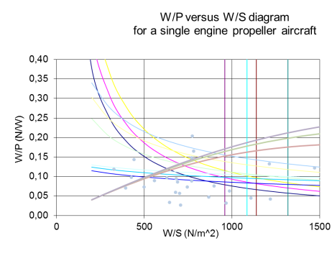
Evaluation of wing stall angle (α_{stall}) and maximum lift coefficient (C_{Lmax})
Question: Why is it important to evaluate the maximum lift coefficient of the wing?
Any assumed value of the wing C_{Lmax} affects the size of the wing surface required to take off and land*. This surface determines the amount of cruise drag and, as a consequence, the aircraft MTOW.
An estimation of C_{Lmax} is also required to understand whether high lift devices are needed - and how large - for take off and landing
Notes:
16
Some few reference values for the maximum lift coefficient of a wing:
Clean wings: 1.2 – 1.5
Wings with flap in the inner part of the wing: 1.6 – 2.0
Wings with regular flap and slats: ≈ 2.4
STOL aircraft: ≈ 3
Wings with large flaps immersed in propwash or jetwash: up to 5
* Remember that in Aerospace design Part I, you made assumptions on CLmax (both for clean and flapped wing) in order to determine a convenient combination of wing and thrust loading.
** In case of very sharp airfoil and large values of sweep angle, at low speed, C_{Lmax} can actually exceed C_{lmax} (see later the effect of the airfoil sharpness parameter)

Slide 17
Evaluation of wing stall angle (α_{stall}) and maximum lift coefficient (C_{Lmax})
Unfortunately the estimation of CL_{max} in conceptual design is rather inaccurate. Possibly, it is the least reliable of all the calculations used in conceptual design*!
For wings featuring high aspect ratio, moderate sweep, and large airfoil nose radius, a good approximation is the following**:
Do NOT use this in your homework assignment
Source Raymer
In case of low aspect ratio and/or substantial sweep, and use of relatively sharp airfoils, a formation of leading edge vortices occurs at high angle of attack.
These vortices have a strong influence on the maximum lifting capability of the wing, up to ~30% of Clmax for very high sweep.
Notes:
17
Some few reference values for the maximum lift coefficient of a wing:
Clean wings: 1.2 – 1.5
Wings with flap in the inner part of the wing: 1.6 – 2.0
Wings with regular flap and slats: ≈ 2.4
STOL aircraft: ≈ 3
Wings with large flaps immersed in propwash or jetwash: up to 5
*Often flight tests (not even wind tunnel tests!) are required for a proper evaluation!
**with Clmax evaluated at the same Reynolds number as for the wing!
DO NOT USE THIS SIMPLIFICATION FOR YOUR ASSIGNMENT. YOU SHALL APPLY THE DATCOM METHOD!

Slide 18
Evaluation of wing stall angle (α_{stall}) and maximum lift coefficient (C_{Lmax})
Unfortunately the estimation of CL_{max} in conceptual design is rather inaccurate. Possibly, it is the least reliable of all the calculations used in conceptual design*!
A DATCOM method* is proposed here to compute stall angle and maximum lift coefficient of a finite length wing.
This method accounts for:
aspect ratio
taper ratio
sweep angle
airfoil type (sharpness factor)
Compressibility**
C_{Lα}
α_{s}
α
Notes:
18
*See also on Corke (pag 181-190) and Raymer (pag 328 – 333)
** Since we are mostly interested into the maximum lift capability of the aircraft at low speed (approach), the compressibility corrections presented next can be neglected

Slide 19
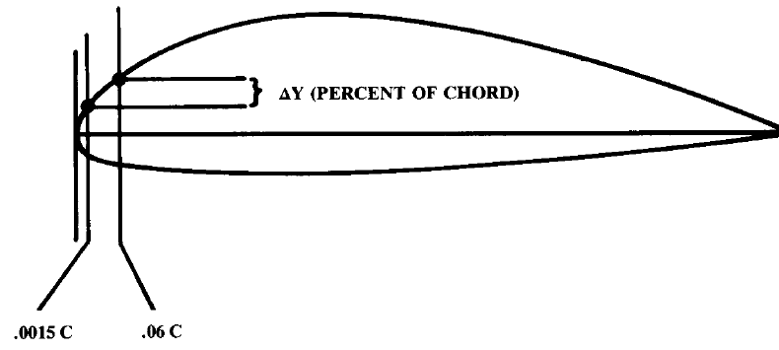
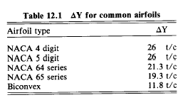
Definition of the LE sharpness parameter (ΔY)
The sharper the LE, the higher the intensity of the generated leading edge vortices; hence*, the higher C_{Lmax}
The shape of the upper part of the airfoil, near the LE**, is mostly responsible for the formation of these vortexes.
A LE sharpness parameter (ΔY) is used as a parameter to calculate the C_{Lmax}; it can be defined as follows:
IF you know the definition of your airfoil you can compute ΔY by yourself, ELSE
Notes:
19
*The smaller ΔY, the sharper the airfoil LE, the higher C_{Lmax}, but only for low aspect ratio wings, or for high aspect ratio wings with moderate to high sweep.
Unswept wings with high aspect ratio are poorly affected by the sharpness parameter.
**One could think that the LE radius should be the right parameter to account for the airfoil sharpness, but ΔY is preferred because it accounts also for the airfoil camber.
Knowing the geometry of the airfoil, it is sufficient to measure the distance from the chord of the points located at 0.15% and 6%on the upper part of the

Slide 20
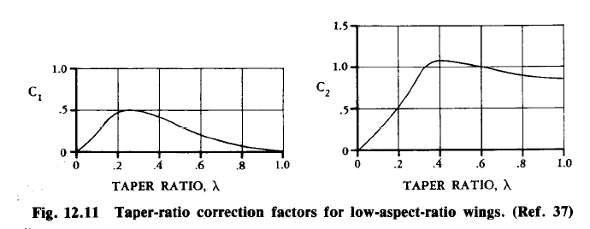
Evaluation of wing stall angle (α_{stall}) and maximum lift coefficient (C_{Lmax})
Two different approaches are proposed: one for high and one for low aspect ratio wings.
For high aspect ratio wings the characteristics of the airfoils have a stronger impact on the wing behaviour, than for low aspect ratio wings, where 3D effects are dominant
Question: How to estimate whether a given wing has a high or low aspect ratio?
IF THEN use high aspect ratio method
Notes:
20
In case of low aspect ratio wings, the 3d effects are so large that the characteristics of the airfoil have much less impact on the wing characteristics, than compared with the case of a high aspect ratio wing!

Slide 21
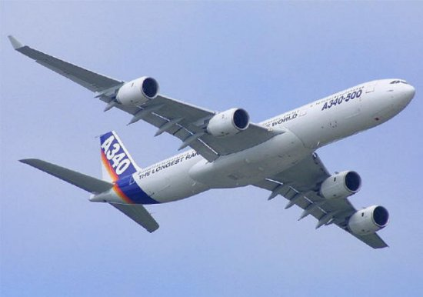
DATCOM method for the Evaluation of stall angle (α_{stall}) and maximum lift coefficient (C_{Lmax}) for high aspect ratio wings

Slide 22
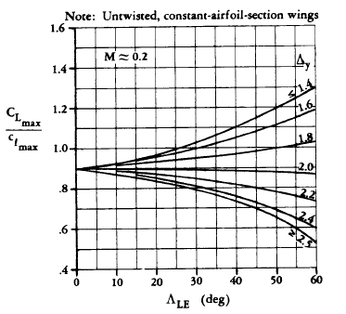


Evaluation of C_{Lmax} for a HIGH aspect ratio wing
Wing section characteristic, at M=0.2 (hence no compressibility effects!).
Use the C_{lmax} value for the right Re number!
*
This term accounts for the effect of Mach number higher than 0.2. When defining the C_{L}-α curve at low speed (e.g., at take off and landing), this term is not relevant.
Source Raymer
Notes:
22
*ATT! :When deriving the value of the airfoil C_{lmax}, as required by the method above for computing C_{Lmax} at take off and landing, make sure to use the specific Re for those conditions (i.e. take off and landing and NOT cruise!!!). If you use the wrong Re (e.g. the one for cruise condition) you might overestimate C_{Lmax} and eventually undersize your high lift devices!!
Computing the value of C_{Lmax} at cruise conditions is generally not relevant for your class of aircraft. Can you explain why?
Note the large influence of the sharpness factor on the maximum lift coefficient of the wing. A sharp airfoil, together with a high sweep angle can yield a maximum lift coefficient even higher than the maximum lift coefficient of the airfoil! Up to 25 deg of sweep, however, C_{Lmax} will never be larger than C_{lmax}.
For wings with airfoils with a sharpness factor larger than 2, C_{Lmax} is ALWAYS lower than C_{lmax}. Very sharp airfoil and a minimum sweep angle of 25 deg are necessary to get C_{Lmax} equal to C_{lmax}.
When you select an airfoil for your wing, you should be aware of the consequences on the wing maximum lift coefficient!

Slide 23
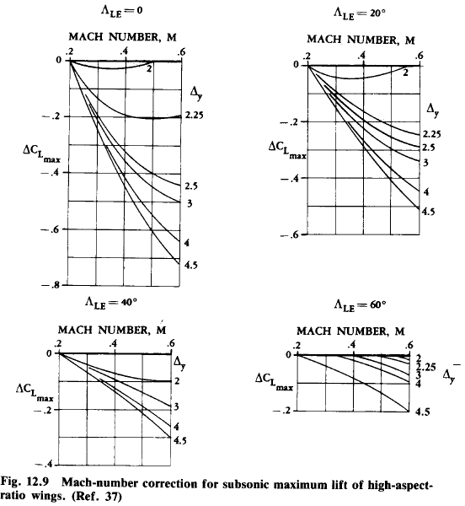

Evaluation of C_{Lmax} for a HIGH aspect ratio wing (cont’d)
Mach number correction for subsonic maximum lift coefficent of high aspect ratio wings
Source Raymer
Notes:
23
Note that the maximum Mach number in these figures is equal to 0.6! It is extremely rare that you need to know the maximum lift capability of your aircraft at higher speed than that! In approach and take off condition (M about 0.2) you can see that the contribution of this term is actually negligible. So, do not waste time using the graphs above!
Besides, an airliner will never flight M=0.6 (or higher) at its maximum lift coefficient…the aerodynamic loads would tear the wings apart!!!
On the other side this can be of interest for aerobatic and air superiority combat aircraft, as well as for aircraft, which needs to cruise in condition very close to CLmax (e.g. operation at very high altitude). In this case it is interesting to include this contribution. It conservatively be assumed that at Mach higher than 0.6, CLmax is not varying.

Slide 24
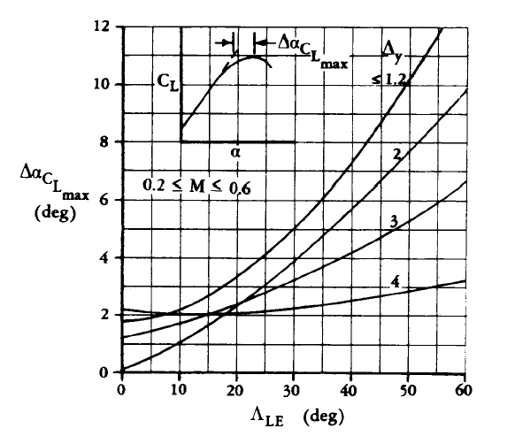

Evaluation of α_{stall} for a HIGH aspect ratio wing
Calculated in the previous two slides
Known characteristic of the wing section (depends on the section camber***)
The wing lift gradient (calculated at the beginning of this lecture).
Calculate it at the right Mach number!
*
This term account for the non linear effects of the LE vortices**
Source Raymer
Notes:
24
When computing the wing characteristics at low speed (e.g., at take off and landing) you cannot use the wing lift gradient computed at cruise Mach number!!!
** The last term Delta_alpha_Clmax helps drawing the curved part of the lift curve. It tells how larger is the stall angle, with respect to the angle at which the extended linear part of the lift curve would reach CLmax.
Indeed, this terms gives you information about the way the wing reaches stall conditions.
Note how the stall is reached abruptly in case of unswept wings with intermediate sharpness factors (delta-Y equal to 2). Can you remember about the stall behaviour of thin, intermediate and thick airfoils discussed in the first lecture?
Note also, how the maximum lift is achieved at high angle of attack in case of high swept wings mounting very sharp airfoil.
*** note how cambered airfoils have lower stall angles, because of the negative value of alpha_zero_lift! The plot above is relative to an untwisted wing. In case of applied twist, you should take the zero lift angle of attack of the airfoil at the mean aerodynamic chord.

Slide 25
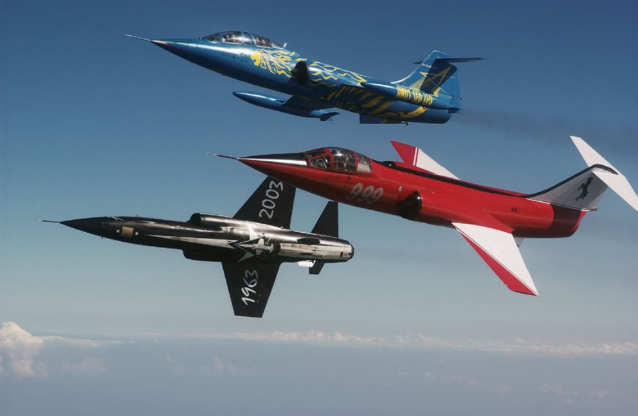
DATCOM method for the evaluation of stall angle (α_{stall}) and maximum lift coefficient (C_{Lmax}) for low aspect ratio wings

Slide 26
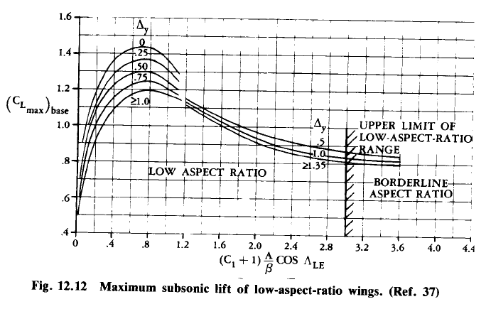
Evaluation of C_{Lmax} for a LOW aspect ratio wing
Note the effect of sharp airfoils in increasing C_{Lmax}!
F(C₁, A, β,Λ_{LE)}
*
Source Raymer
Notes:
26
*Use the right value of M (and β)! Do not use the cruise value when you are computing the low speed lift curve of your aircraft (e.g., at take off and landing!)
Fig 12.12 corresponds to fig 9.12 Corke
Taper ratio/C1 curve corresponds to fig 9.8 Corke

Slide 27
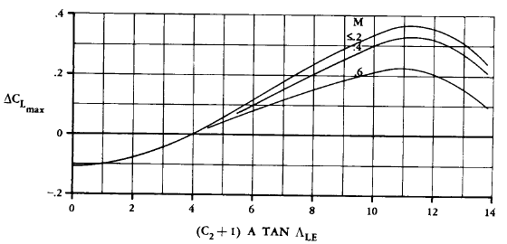
Evaluation of C_{Lmax} for a LOW aspect ratio wing (cont’d)
This term accounts for the compressibility effects on C_{Lmax}
F(C₂, A, M,Λ_{LE)}
*
Source Raymer
Notes:
27
*Use the right value of M (and β)! Do not use the cruise value when you are computing the low speed lift curve of your aircraft (e.g., at take off and landing!). The curves give appropriate result until Mach = 0.6. Beyond that value you can conservatively assume CLmax to remain constant
Fig 12.12 corresponds to fig 9.12 Corke
Taper ratio/C2 curve “ to fig 9.14 Corke

Slide 28
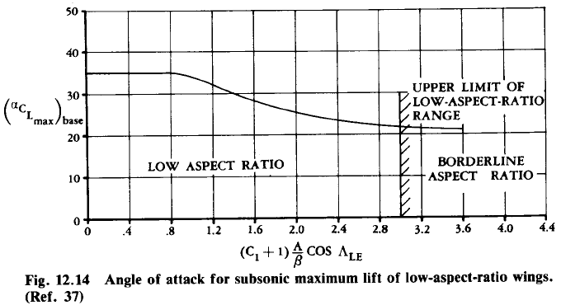
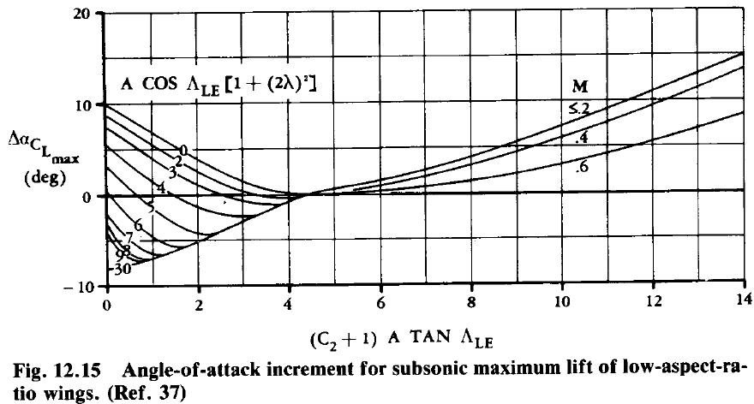
Evaluation of α_{stall} for a LOW aspect ratio wing
Source Raymer
Notes:
28
Note how delta-alphacLmax depends on Mach number only if the value in the abscissae is larger than 4!
Fig12.14 corresponds to fig 9.15 Corke
Fig 12.15 “ to fig 9.16 Corke
Taper ratio curve/ C2 “ to fig 9.14 Corke

Slide 29
2. Aircraft Drag polar:
Introduction
Notes:
29

Slide 30

What is the efficiency of the aircraft system in converting fuel into useful energy?
<10%
10-20%
20-40%
40-60%
60-80%
>80%
Air transportation moves objects from zero velocity and zero altitude to zero velocity and zero altitude. So the useful work done is ZERO!
The energy we spend on air transportation is just to defeat drag!
23ae2111

Slide 31
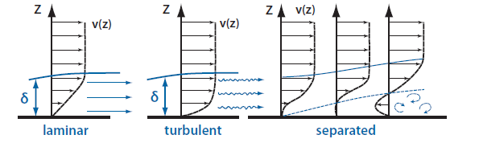
The origin of drag
There are only two ways that the air flow and the airplane can act upon each other:
Pressure – perpendicular to surface
Friction – tangential to surface
Origin of pressure: the change in flow velocity due to the body shape
Origin of friction: no slip condition – the flow velocity is zero at the surface.
The region close to the surface, in which the flow velocity increases from zero to 99% of the outer velocity is called “boundary layer”.
The boundary layer can be “laminar” or “turbulent”.
Fig. source: Nicolai
Notes:
Due to Bernoulli’s equation the total pressure (the sum of the static and dynamic pressure) is constant along a subsonic streamline. If the local air velocity goes up (increase in dynamic pressure) the static pressure decreases. Similarly if the local air velocity goes down the static pressure increases.
No slip condition: As the aircraft moves forward, the air molecules slide over its skin. The molecules closest to the skin act as if they are stuck to the aircraft skin, moving with the aircraft.
If the air molecules inside the boundary layer slide over each other in an orderly fashion, the boundary layer is said to be “laminar”. If the molecules shear in a disorderly fashion, the boundary layer is “turbulent”.
For low Reynolds numbers (less than half million for smooth surfaces) the BL is usually laminar. For higher Reynolds number (above half million for smooth surfaces) the boundary layer is turbulent. If the surface is rough the BL can be turbulent for even lower Reynolds number than half a million.

Slide 32
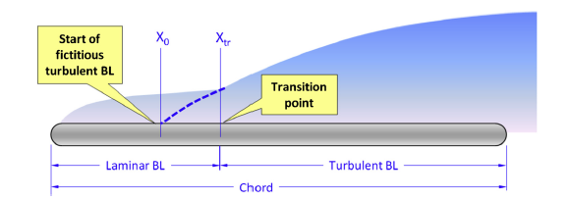
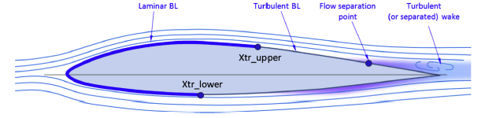
Laminar vs turbulent boundary layer
Laminar Boundary layer
Thinner
Lower friction
More prone to separation
Turbulent boundary layer
Thicker
Higher friction
Higher energy → less prone to separation
Fig. source: Gudmundsson

Slide 33
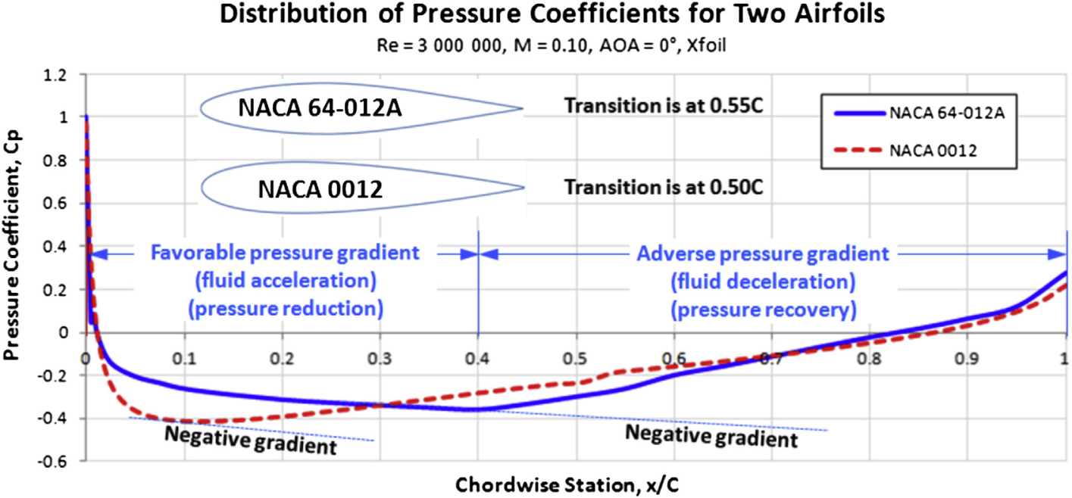
Laminar vs turbulent boundary layer
Effect of roughness: smoother surface can sustain laminar BL more than a rough surface.
Effect of geometry: position of the maximum thickness controls the pressure gradient on an airfoil
Moving the position of the maximum thickness back postpones the transition. However we should be able to increase the pressure again without having separation!
Notes:
The presence of rivet-heads, uneven plate joints, insects, ice, and even rain can destabilize the flow and start transition.

Slide 34
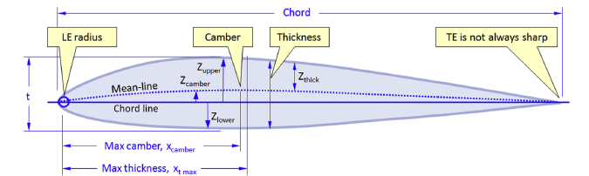
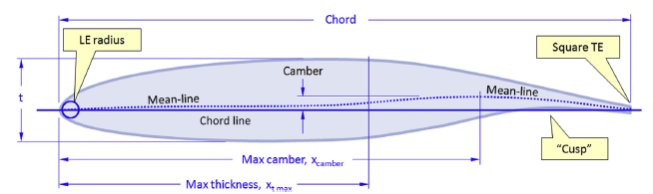
Laminar vs turbulent boundary layer
NLF airfoils (Natural Laminar Flow): airfoils that can sustain laminar flow as far as 50% (or even more) of the chord naturally.
Ordinary airfoil
NLF airfoil

Slide 35
Different Drag Components
Skin friction drag. The drag on a body resulting from viscous shearing stresses over its wetted surface.
Pressure drag (or form drag). The drag on a body resulting from the integrated effect of the static pressure acting normal to its surface resolved in the drag direction.
Profile drag (or parasite drag). Usually defined as the sum of the skin friction drag and the pressure drag for a two-dimensional airfoil.
Viscous drag-due-to-lift. The drag that results due to the integrated effect of the static pressure acting normal to its surface (resolved in the drag direction) when the airfoil angle-of-attack is increased to generate lift. (Note: It is present without vortices.)
Inviscid drag-due-to-lift (or induced drag). The drag that results from the influence of a trailing vortex (downstream of a lifting surface of finite aspect ratio) on the wing aerodynamic center. (Note: It is present with or without viscosity).
Interference drag. The increment in drag resulting from bringing two bodies into proximity to each other; for example, the total drag of a wing–fuselage combination will usually be greater than the sum of the wing drag and fuselage drag independent of one another.
…

Slide 36
Different Drag Components
Trim drag. The increment in drag resulting from the aerodynamic forces required to trim the aircraft about its center of gravity; usually this takes the form of added drag-due-to-lift on the horizontal tail.
Base drag. The specific contribution to the pressure drag attributed to a blunt afterbody.
Wave drag. Only exists with supersonic flow; this is a pressure drag resulting from noncanceling static pressure components on either side of a shock wave acting on the surface of the body from which the wave is emanating.
Excrescence drag (or protuberance drag). The drag associated with antennas, total pressure probes (part of the air data system), and other protrusions above the exterior of the aircraft; external fuel tanks, missiles, and bombs are also considered excrescence drag items.
Cooling drag. The drag resulting from the momentum lost by the air that passes through the powerplant installation (i.e., the heat exchanger) for cooling the engine, oil, and so on.
Ram drag. The drag resulting from the momentum lost by the air as it slows down to enter an inlet.

Slide 37

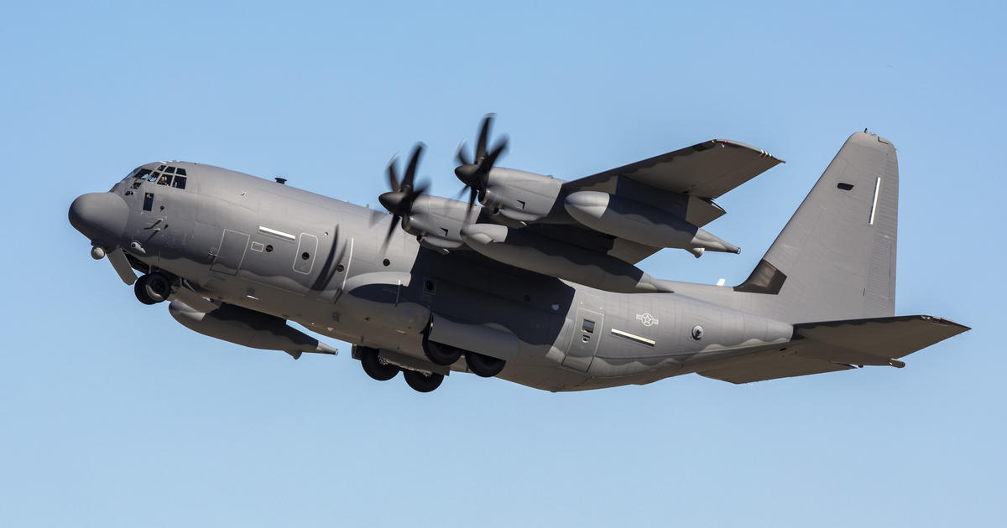
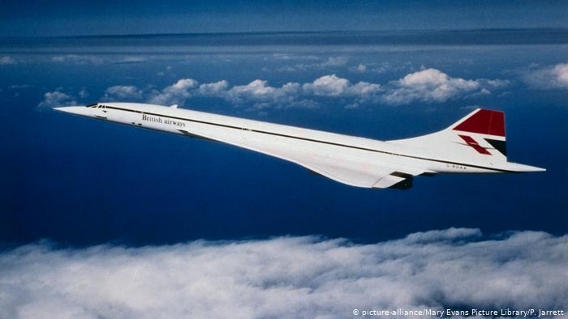
What is the most predominant drag component during the flight?
D_{i} ≈D_{v}
D_{w} > D_{v} >D_{i}
D_{misc} (D_{trim}) predominant
At low speed
D_{i} >D_{v}

Slide 38
Drag count and drag area
Drag is usually spoken of as so many counts.
Each drag count is 0.0001 drag coefficient. For example 38 drag counts mean a drag coefficient of 0.0038
Drag force over the dynamic pressure (D/q) is a commonly used parameter and has a unit of square meter (or feet). D/q is called the drag area.
If the drag area is multiplied by the dynamic pressure is yields the drag force.
If the drag area is divided by the wing reference area it yields the drag coefficient.

Slide 39
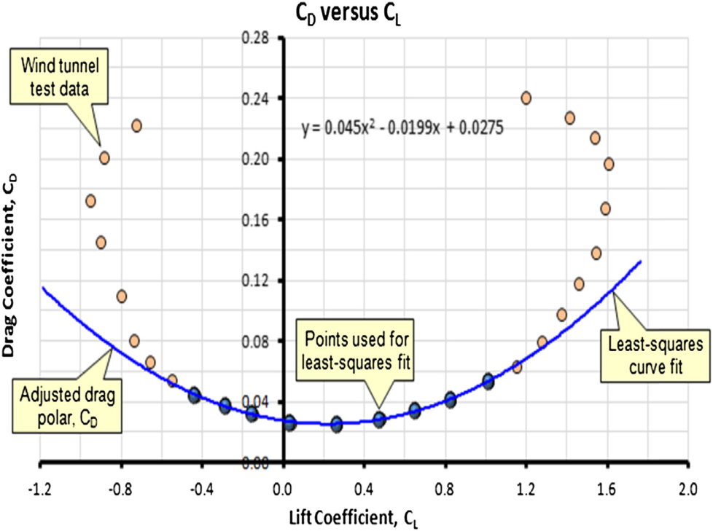
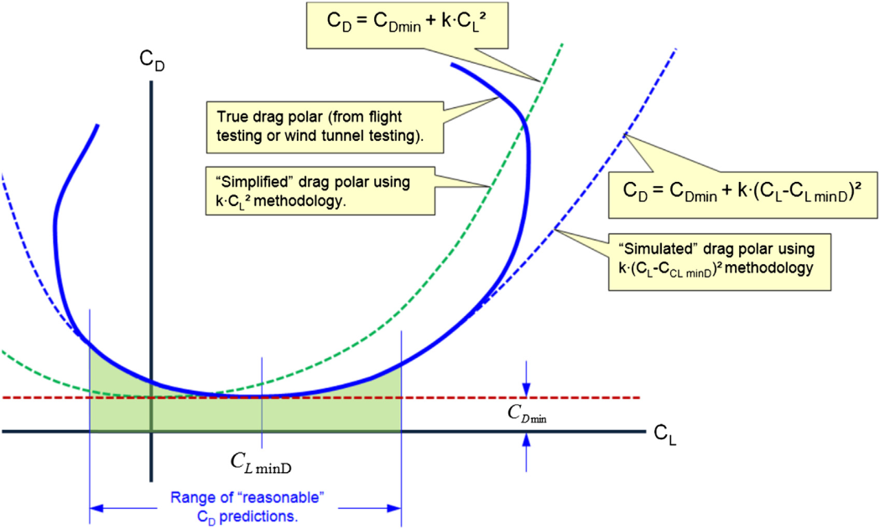
Drag polar
If we look at the experimental results for drag vs lift, we can see that the drag varies quadratically with lift.
So we can approximate drag as:
For uncambered wings
For cambered wings
For wings with moderate camber, CLminD is usually small so the first equation can be used.

Slide 40
Drag polar
Zero lift drag
e = Oswald efficiency factor
A = Aspect Ratio
From classical theory the induced drag of a wing with elliptical lift distribution is equal to , however few wings have an elliptical lift distribution. Also the separation drag is not counted in this formula. The extra drag due to nonelliptical lift and separation can be accounted for using e.
Drag estimation includes two parts: estimating the zero lift drag, and estimating the Oswald efficiency factor
To properly estimate the drag, we need consider the whole aircraft!

Slide 41
The Aircraft Drag polar curve:
2.2: Zero lift drag estimation methods
Notes:
41

Slide 42
Zero lift drag: methods
Very fast methods usually used on early conceptual design stages (statistical regression based on similar aircraft)
A fast method to estimate CD0 for each aircraft component.
The component build-up method where CD0 is estimated in a more accurate way considering also some flow properties.
Notes:
Clean aircraft configuration means the flaps and landing gears are retracted.

Slide 43
1-Very fast estimation of zero lift drag
Aircraft | Cfe
Bomber | 0.0030
Civil transport | 0.0026
Military cargo | 0.0035
Air force fighter | 0.0035
Navy fighter | 0.0040
Clean supersonic cruise aircraft | 0.0025
Light aircraft – single engine | 0.0055
Light aircraft – twin engine | 0.0045
Prop seaplane | 0.0065
Jet seaplane | 0.0040
Useful for early conceptual design phase, where aircraft layout is not yet available.
The fastest method for CD0 estimation of CLEAN aircraft configuration is as follows:
Cfe is equivalent skin friction coefficient, Swet is the aircraft wetted area and Sref is the wing reference area.
Table source: Raymer
Notes:
Clean aircraft configuration means the flaps and landing gears are retracted.

Slide 44
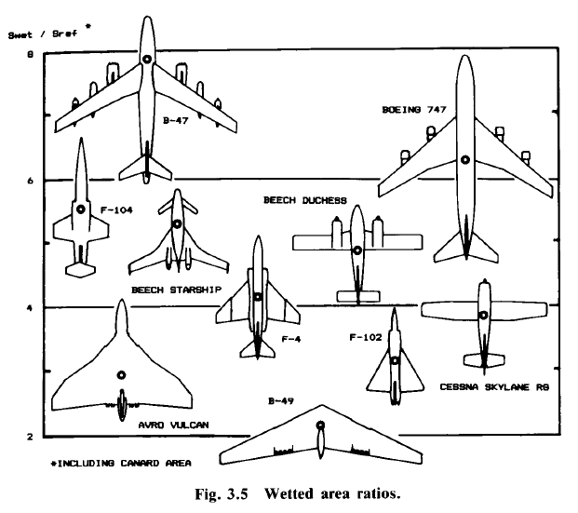
1-Very fast estimation of zero lift drag
S_{wet}/S
8
Boeing 747
B-47
6
Beech Duchess
F104
Beech Duchess
Beech Starship
4
F4
F102
F4
B49
Cessna Skylane R9
2
Avro Vulcan
Table source: Raymer

Slide 45
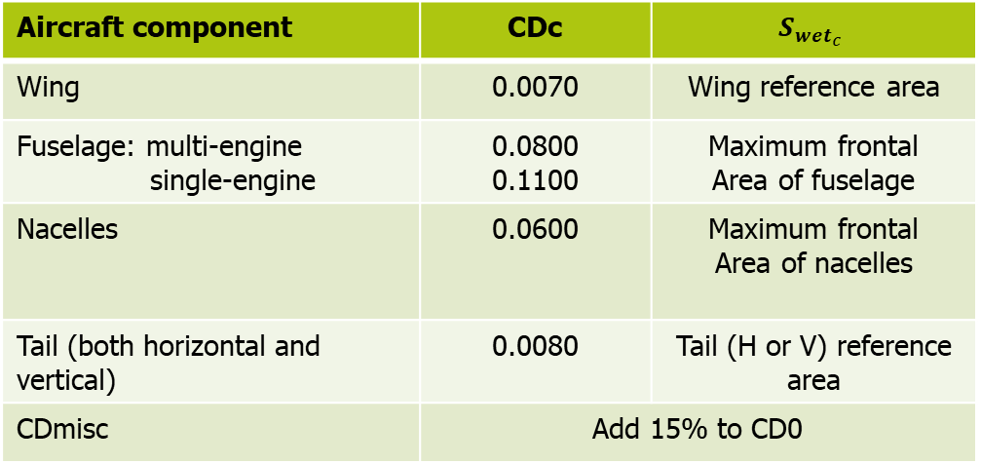
2-Fast estimation of zero lift drag - Prop
A fast method for CD0 estimation of CLEAN aircraft configuration is as follows:
Drag increment for interference, roughness and excrescence
Aircraft component | CDc | $$S_{{wet}_{c}}$$
Wing | 0.0070 | Wing reference area
Fuselage: multi-engine single-engine | 0.0800 0.1100 | Maximum frontal Area of fuselage
Nacelles | 0.0600 | Maximum frontal Area of nacelles
Tail (both horizontal and vertical) | 0.0080 | Tail (H or V) reference area
CDmisc | Add 15% to CD0

Slide 46
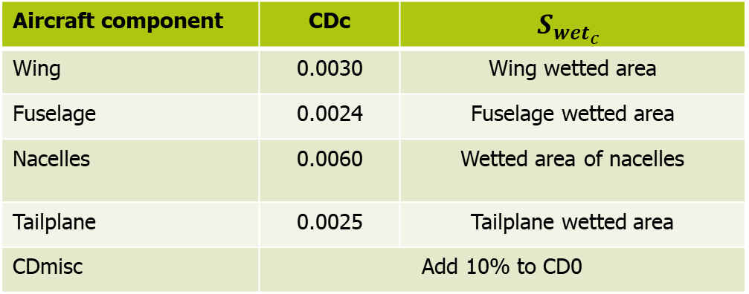
Fast estimation of zero lift drag - Jet
A fast method for CD0 estimation of CLEAN aircraft configuration is as follows:
Drag increment for interference, roughness and excrescence
Aircraft component | CDc | $$S_{{wet}_{c}}$$
Wing | 0.0030 | Wing wetted area
Fuselage | 0.0024 | Fuselage wetted area
Nacelles | 0.0060 | Wetted area of nacelles
Tailplane | 0.0025 | Tailplane wetted area
CDmisc | Add 10% to CD0

Slide 47
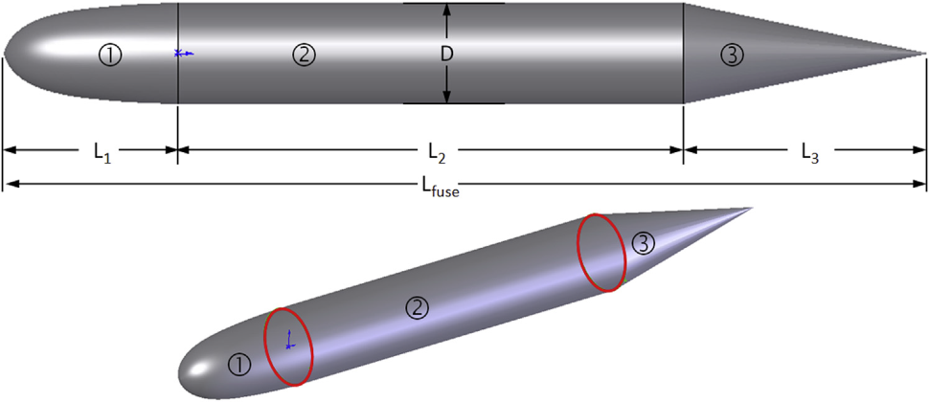
2-Component wetted area
Wing wetted area:
Horizontal tail wetted area:
Vertical tail wetted area:
Fuselage wetted area:
Notes:
Subscription “exp” mean exposed wing/tail area

Slide 48
3-The component drag build-up method
This method estimates the subsonic parasite drag of each aircraft component using:
flat plate skin friction coefficient (Cf), that estimates the component friction drag
Component form factor (FF), that estimates the pressure drag due to viscous separation
Interference factor (IF) , that estimates the effect of each components on the drag of the other components
Miscellaneous drag includes special features such as flaps, landing gear etc.
Notes:
The miscellaneous drag is drag attributed to miscellaneous sources, such as antennas, fuel caps, air flow through
small gaps (such as those between control surfaces and the lifting surface to which they are mounted), as well as control system components (bellcranks, hinges, etc.), inlets, outlets, antennas, and so on.

Slide 49
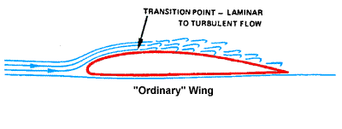
3-Laminar vs turbulent boundary layer
It depends on the Reynolds number and on the type of boundary layer
Laminar Boundary layer
Thinner
Lower friction
More prone to separation
Turbulent boundary layer
Thicker
Higher friction
Higher energy
Higher resistance against separation (since it has higher energy)
Fig. source: Gudmundsson

Slide 50
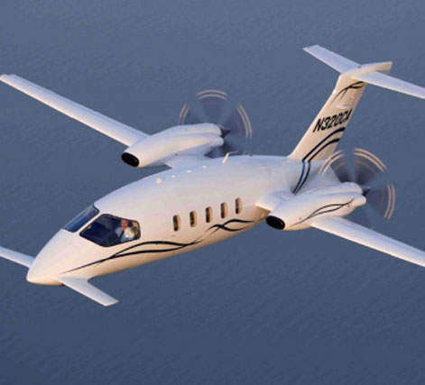
3-Flat plate skin friction coefficient
Laminar or turbulent boundary layer? We have to guess!
Laminar flow | Fuselage (%) | Wing and tail (%)
General aviation – classic production metal | 0 | 10
General aviation – smooth metal (no rivets or cracks) | 10 | 35
General aviation – smooth molded composites | 25 | 50
Sailplane – smooth molded composites | 35 | 70
Civil jet – classic production metal | 5 | 10
Military aircraft | 0 | 0
Piaggio GP180 laminar flow:
50% of the wing and tails, 20-35% of the fuselage

Slide 51
3-Flat plate skin friction coefficient
Laminar:
Turbulent:
Subsonic
Surface | k (m)
Camouflage paint on aluminum | 1.015 x 10^-5
Smooth paint | 0.634 x 10^-5
Production sheet metal | 0.405 x 10^-5
Polished sheet metal | 0.152 x 10^-5
Smooth molded composite | 0.052 x 10^-5
Transonic,
supersonic
Actual Re
Cutoff Re
Cutoff Re determines the effect of roughness on transition
The total Cf is the weighted average of the laminar and the turbulent Cf. For example if you have 10% laminar and 90% turbulent flow then: Cf = 0,1Cf_laminar + 0,9 Cf_turbulent

Slide 52
3-Component form factor
Wing, tail, strut and pylon:
Fuselage and smooth canopy:
Nacelle and smooth external store:
where
Notes:
(x/c)m is the position of the maximum thickness. (t/c) is the average thickness to chord ratio and Lambda_m is the sweep angle at the position of the maximum thickness.
l is the length and d is diameter. Amax is the maximum frontal area.

Slide 53
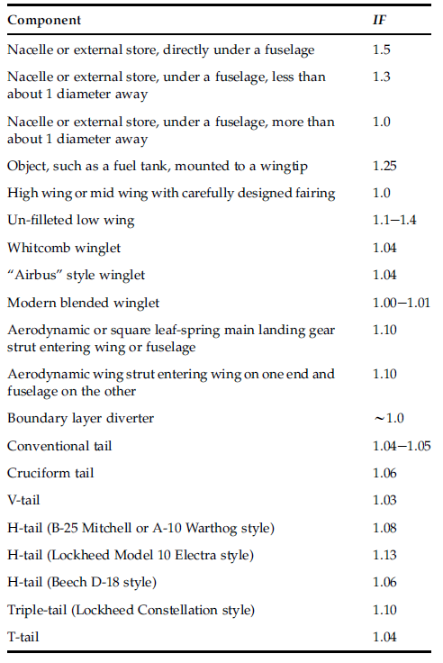
3-Component interference factor
The interference drag is due to:
Boundary layer interaction at the connection of two component resulting in a thicker BL.
A component is immersed in the supervelocity around another component *.
Notes:
The airflow around a body such as a fuselage is accelerated to a speed higher than the freestream speed. The air is literally going faster, so it has higher dynamic pressure. This increases drag for any component immersed in that flow.

Slide 54
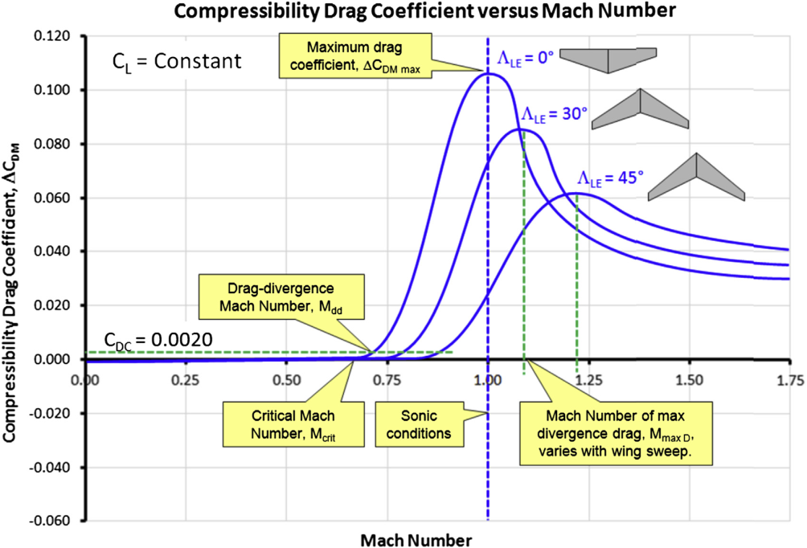
Miscellaneous drag - Wave drag
Drag divergence Mach number.
Definition 1:
Definition 2:
Estimation of MDD (by Mason):
k_{a} is the technology factor of the airfoil that is considered. It is constant for a given family of airfoils that differ only by their thickness. Ka is equal to 0.87 for NACA 6-series airfoils and 0.935 for supercritical airfoils
Notes:
MDD is called Mach of Drag Rise and it is defined as the value of Mach in which the drag increment is equal to 20 counts

Slide 55
Miscellaneous drag - Wave drag
Additional drag due to compressibility:
For :
For :
For :

Slide 56
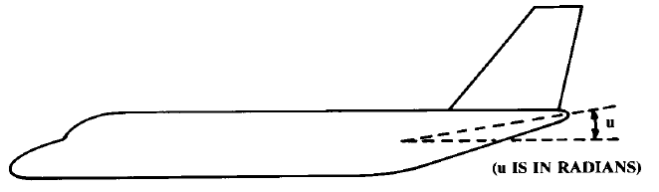
Miscellaneous drag – fuselage upsweep and base area
Additional drag due to fuselage upsweep:
u should be in radian. Amax is the maximum fuselage cross-sectional area.
Fuselage base drag
M is the Much number (only subsonic) and A_{base} is the fuselage base area

Slide 57
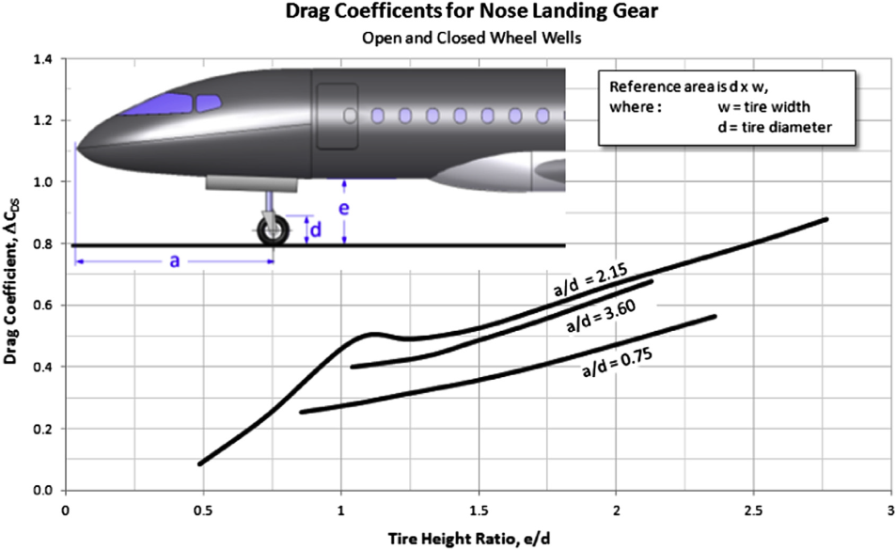
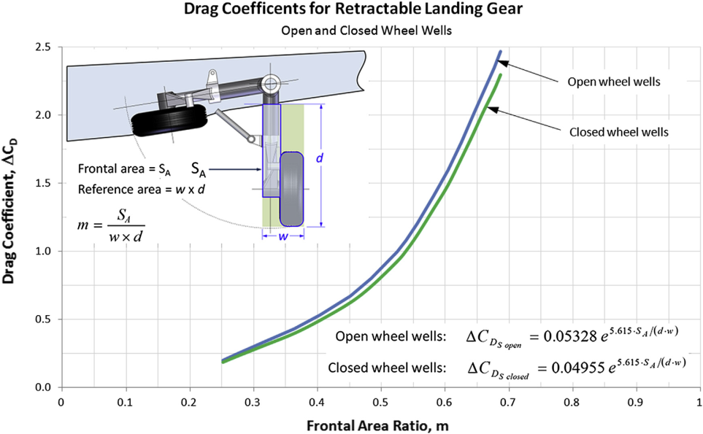
Miscellaneous drag – landing gear
The left graph shows the drag of all the main landing gears
The LG drag coefficient in these graphs is scaled using the LG reference area defined as (Ss = d x w). To add the LG drag coefficient to the aircraft CD0, the drag coefficient based on the wing reference area should be calculated:

Slide 58
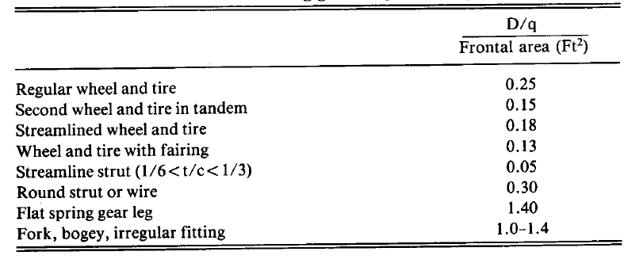
Miscellaneous drag – landing gear

Slide 59
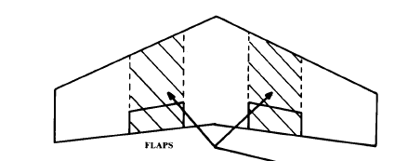
Miscellaneous drag – flap
Fflap = 0,0144 for plain flap and 0,0074 for slotted flaps
Cf = Chord length of flap
Sflap = wing area affected by flap
Delta flap should be in degree
Sflap
Only for flap deflection higher than 10 degrees!

Slide 60
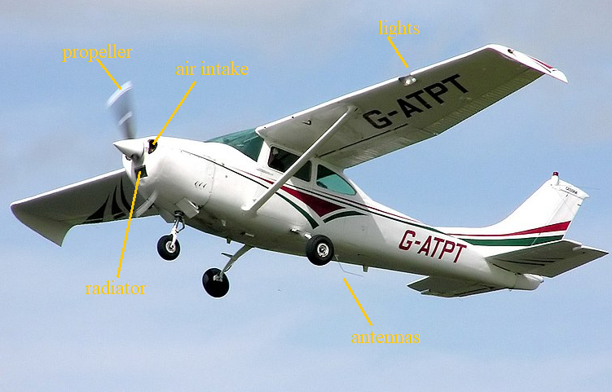
Miscellaneous drag – Excrescence and leakage
For propeller aircraft 5-10 % of total CD0
For jet transport 2-5% of total CD0
For non-stealth fighters 10-15% of total CD0
For stealth fighters 3-5% of total CD0

Slide 61
Aircraft Drag polar curve
2.4: Estimation of the drag due to lift
Notes:
61

Slide 62

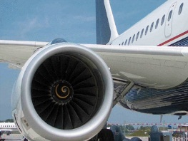
Oswald efficiency factor
Drag polar:
e = Oswald efficiency factor
For straight wings :
For swept wings:
Effect of flap deflection: increasing e by
Fuselage mounted engines
Wing mounted engines

Slide 63
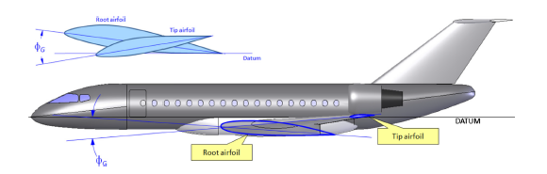
Effect of wing twist
If the wing is twisted, different sections of the wing sees different angles of attack. So even if the total lift is zero, we still have local lift. Besides the change is wing twist changes the lift distribution on the wing that alters the induced drag.
The effect of wing twist on the lift depended drag can be estimated as follows:
is the twist angle at tip in degree
is the twist angle at the mean geometric chord in degree

Slide 64
Effect of wing tip
The effect of the wing tip shape can be taken into account by modifying the wing aspect ratio:
is the so-called “effective aspect ratio”. The effect of the wing tip device can be seen in .
So first the effective aspect ratio should be determined based on the wing tip shape and then it should be used in all the equations for lift and drag estimation.

Slide 65
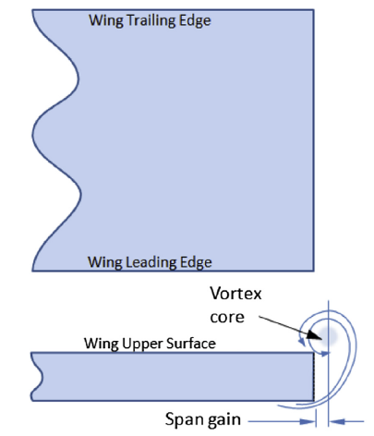


Effect of wing tip
Wing tip shape affect notably the flow , hence the effective AR
a b c

Slide 66

Effect of wing tip
Source: GUDMUNDSSON

Slide 67




Effect of wing tip
Raked wing tip Winglet
h

Slide 68

Ground effect
Ground effect happens when the aircraft is close to the ground, say less than half the span away.
The ground gets in the way of the downwash effectively preventing it from fully developing.
This effect can be counted by multiplying K by a factor:

Slide 69
What’s next
What if the calculated CL_{max} is still not enough to guarantee adequate performance during landing and take-off ?
What are the other important sub-functions that are fulfilled by subsystem in the wing? How can we size them?

Slide 70
3.Additional exercises
Notes:
70

Slide 71

Problem
66/95
Question slide
Join at: vevox.app
ID: 165-949-420
AoA(trim) = 0.06 [deg]
0%
AoA(trim) = 0.29 [deg]
0%
AoA(trim) = 0.55 [deg]
0%
AoA(trim) = 3.44 [deg]
0%
AoA(trim) = 5.45 [deg]
0%
Mot enough data
0%

Slide 72

What aircraft has superior performance (in terms of range)?
95/4
Join at: vevox.app
ID: 165-949-420
Question slide
The B47 has superior performance
0%
The Avro-Vulcan has superior performance
0%
They both present equal/similar performance
0%
Not enough information
0%

Slide 73

Design philosophies
Parameter | B47 | Avro Vulcan
Wing area [m2] | 133 | 320
Span [m] | 35.4 | 30.2
Aspect Ratio | 9.43 | 2.84
W/S [kg/m2] | 690 | 212
CD0 | 0.0198 | 0.0069
CLdes | 0.68 | 0.24
L/D | 17.25 | 17.1
Aspect ratio wetted | 1.2 | 1.1
The engine installation was driving the design together with “secondary” aerodynamics aspects such as: engine performance, accessibility, manuever load, cargo and fuselage volume etc…

Slide 74
Questions?
Notes:
74

Slide 75
C_{L}
…
0.5
0.4
0.3
0.2
0.1
-5
-4
-3
-2
-1
1
2
3
4
5
6
7
α
…

